Slide 1
What’s Cooking?
Sean Arackal, Alexander Bell, Spencer Greene, Axel Luca, Jamie Ortiz

Slide 2
About The Team
Alexander Bell (CS MS ‘25)
Axel Luca (CS BS/MS ‘25)
Sean Arackal (CS BS/MS ‘26)
Jamie Ortiz (CS BS ‘26)
Spencer Greene (CS BS/MS ‘26)

Slide 3
About the Team
Alexander Bell: Software Engineering (JavaScript, React), Python, MySQL, Git
I’m interested in learning how to query data efficiently, creating ERD diagrams, and Using CSS and HTML to make functional websites that also look good.
Contributions: Set up team meetings, tested triggers and views not already covered by current data with the help of Sean, and helped write the Project Overview section in the report. Helped create the recipe builder page with Axel, and connected the webpage form to the database with INSERT statements that also prevent simple SQL Injection attacks by using prepared statements. Helped Sean debug features related to displaying reviews and accessing user profiles. In addition, wrote the sections "The Website Layout", "Testing Triggers \& Views", and "Conclusions" including it's subsections, and helped review, edit, and format the paper,
Axel Luca: Software Engineering (JavaScript, React), Python, Oracle, MySQL, PostgreSQL, Docker
Primary editor of the project intent and proposal and wrote up the whole section about the ER diagram for both documents. Made most of the presentation for the project proposal. Scraped and cleaned all of the data we need for our project with help from scripts provided by Jaime. Main editor of our project’s ER diagram. Provided the initial MySQL server we used for the project. Translated our application’s ER diagram to a MySQL schema. Came up with and wrote up the MySQL views and triggers we plan to use for our project. Provided the default schema needed for the MySQL cloud server provided by Spencer that we’re using for our project now. Expanded on the ER diagram section for this project progress report, wrote up the project progress report’s MySQL background, and wrote up part of the project abstract for this project progress report along with the normalization analysis and query optimization as well. As for the website, I made the entire page displaying the 3 views created in our database inside visible tables on the GUI. Additionally, I also worked with Sean to implement some of the functionality related to features such as "Saving and Unsaving Recipes", "Adding Reviews", and "Displaying Reviews" on recipes. Moreover, I also collaborated with Alex to implement the functionality required for users to be able to create recipes and add their ingredients.

Slide 4
About the Team (Continued)
Jamie Ortiz: Software Development (python, C/C++, JS, GIT, pandas), Airflow, Docker, PostgreSQL
What you want to learn/practice: Expand my knowledge on design and use of different DB. Learn to manage them correctly, and connect them efficiently with various software to create functional applications.
Contributions: Created python scripts to retrieve data that was not already in our database. Together with Spencer we created the backend and frontend for the website, we connected it to MySQL. Our website queries the recipes from the database with all the information from them. Recipe filtering, sorting and searching, by name, ingredients, calories, ratings... After that we will include a system to leave reviews. Helped write all the paper like the rest of the team, documented things like react, things we used for the web. Used React.js, Node.js, express, bootstrap. Connection pool to MySQL done with mysql2/promise.
Sean Arackal: Software Engineering (JavaScript, React, Node/Express, MongoDB), Database Management Systems I (Oracle DB), Git I am interested in gaining a higher level understanding of how databases work. I would also like to take that knowledge and apply it to our project while also focusing on the design of it.
Contributions: Tested triggers and views created by other members with Alex. Wrote up the abstract for the project progress. Reviewed and edited the paper as needed. Helped write a majority of functionality related to features such as "Saving and Unsaving Recipes", "Adding Reviews", and "Displaying Reviews" on recipes with help from Axel and Alex. Wrote the entirety of the User Profile page. Improved UI gently throughout the project.

Slide 5
About the Team (Continued)
Spencer Greene: Hardware-oriented software engineering (C). Databases (Oracle, MySQL, MongoDB). Relevant Software Engineering Skills (Java, Python, Git)
I am interested in expanding my backend programming knowledge (client/server connection), broadening my skills with databases, and exploring more front-end skills along the way. I hope to do this while being an effective and organized team member.
Contributions:Backend specialist. Managed the dedicated server in the Cloud, including installing all software on this server to run necessary services, and created the infrastructure to support the domain being hosted. This involved pointing the domain to the web server, and creating a reverse proxy that serves the running client/server instance to the web. Additionally, installed and deployed MySQL on the server, allowing a 24/7 running instance of our data to be accessible by the team. Assisted Jamie with backend/frontend development (in developing the website with Node.JS, React, and Express). Documentalist (formatted the report in IEEE format with LaTeX).

Slide 6
What did we do?
Worked to create a community-driven forum for recipe creation
Scraped recipes from the dataset found at https://www.kaggle.com/datasets/dimitryzub/allrecipes-all-us-recipes-by-state
Built out database structure
Created a frontend for our program, hosted at https://whats-cooking.fyi/
Users can build recipes and publish them for the community to see
Users are able to come and comment/rate on those recipes
Users are able to filter recipes among various metrics, such as:
Ingredients
Rating
Calories
Recipe Name
Created and tested triggers & views
Notes:
Jamie spencer

Slide 7


How did we do this?
Databases, of course.
We will use a MySQL database to store our user data, comment information, recipe data, and ingredient data.
Website Technologies
React, Node.JS, and Express.JS
Notes:
jaime/spencer?

Slide 8
Why did we choose MySQL?
In order to successfully complete, we decided to use MySQL as our backend. Some of the primary reasons for this choice were that MySQL is open-source, that it is used in multiple kinds of applications, its ease of setup, and the features it provides. To be more precise, the fact that MySQL is open-source is what allowed us to easily download and set up some of its products such as MySQLWorkbench, and make a MySQL server that could be shared remotely across different computers. In addition to this, examples of applications that rely on MySQL for functionality include Netflix, Uber, and Airbnb (Oracle, 2021). Moreover, MySQL provides several functionality features that we think are essential for our project such as views and triggers (Thomsen, 2002). Along with those, some additional features we thought would be useful for that project that MySQL includes are a LIMIT clause that allows users to limit the amount of rows shown when running queries, and an IFNULL function that allows users to specify a default value to return if a desired result returns NULL (Siahaan & Sianipar, 2019; Stephens & Russell, 2004).
Notes:
Axel

Slide 9
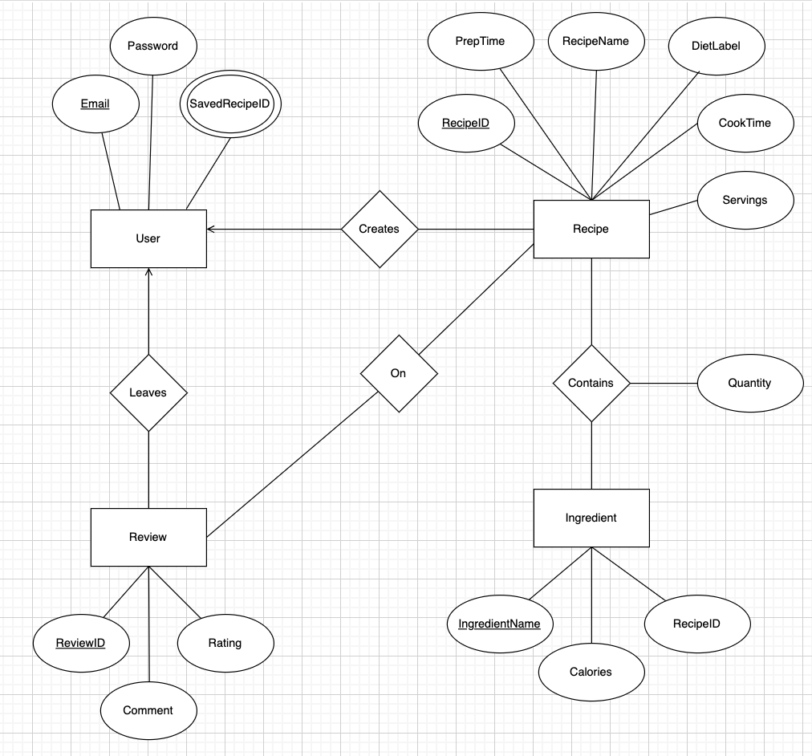
Initial ERD
Notes:
Axel

Slide 10
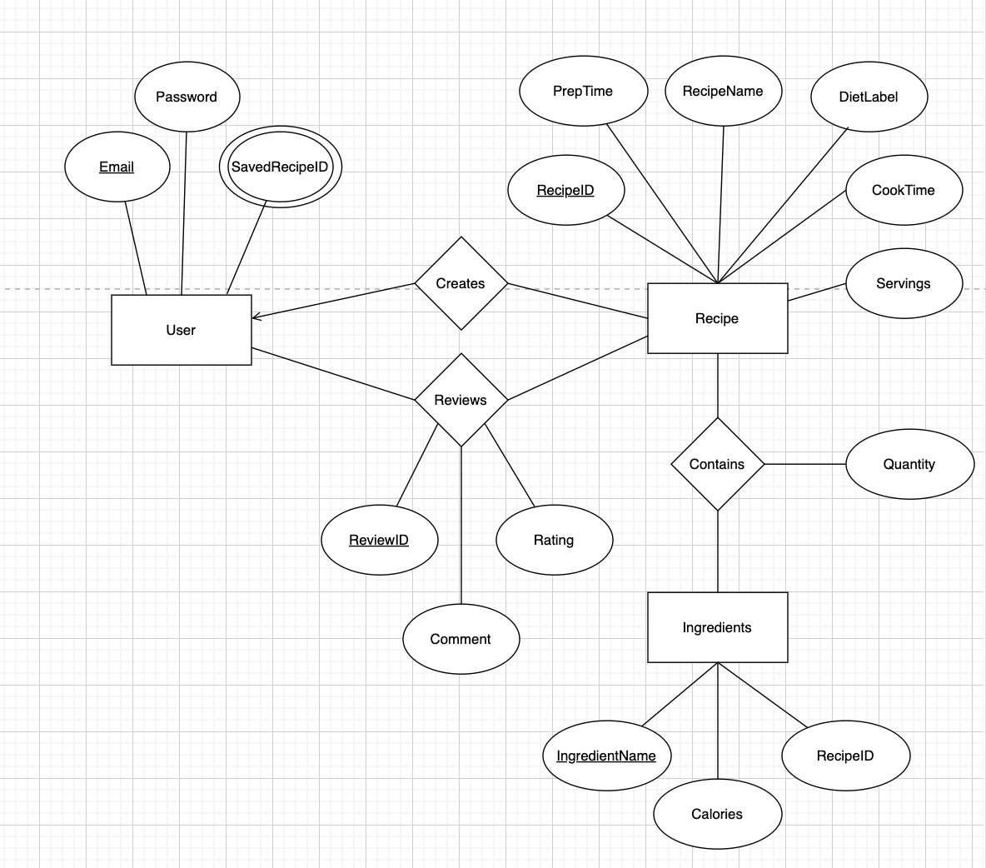
ERD v2
Notes:
Axel

Slide 11
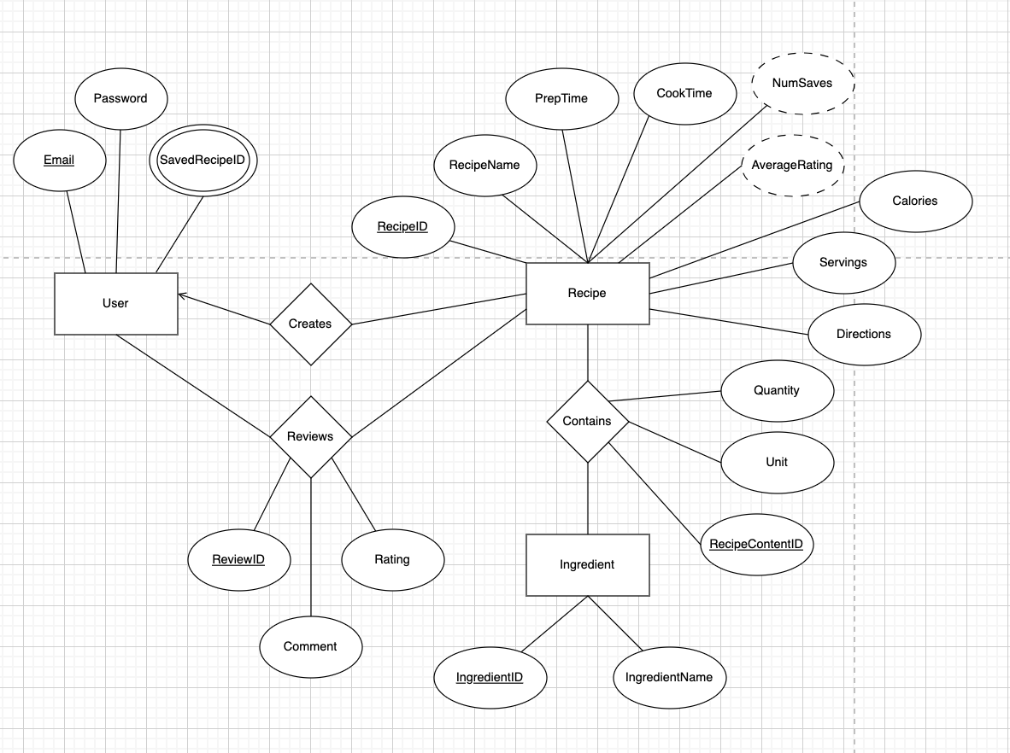
ERD v3
Notes:
Axel

Slide 12
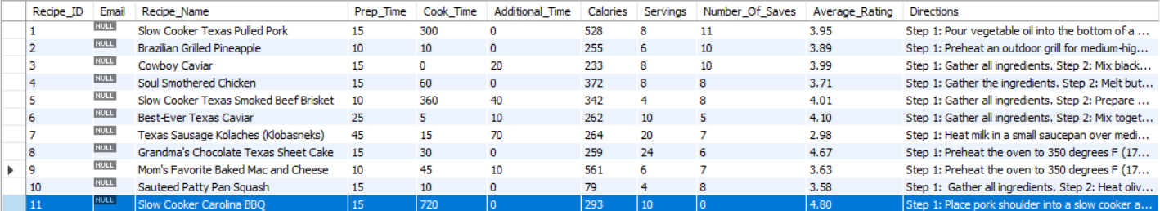
Testing Triggers
Trigger: Prevent high-quality recipes from being deleted
This trigger correctly prevents recipe ID = 11 (Whose average rating is 4.80) from being removed from the recipes table
Notes:
sean/alex

Slide 13
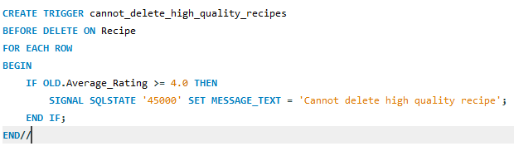
Trigger implementation

Slide 14
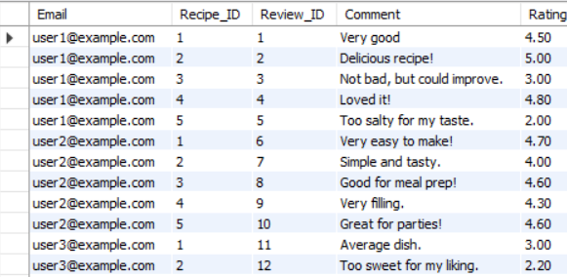
Testing Triggers
Trigger: Increment review ID by one every time a new review is created We couldn’t use the Auto Increment feature of MySQL Due to the structure of our Database, so we wanted to test to ensure that Review ID is being correctly incremented

Slide 15
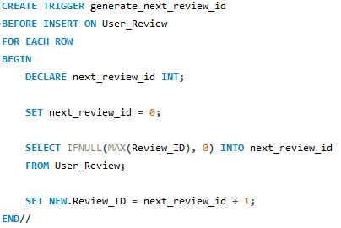
Trigger Implementation

Slide 16
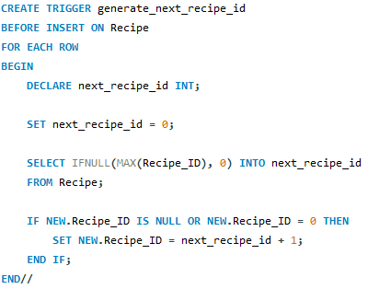
Trigger Implementation

Slide 17
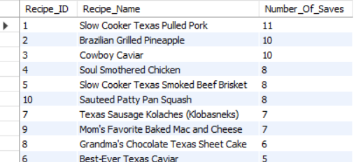
Testing Views
This view’s purpose is to get 10 most saved recipes. This also tested the trigger that calculates the new number of saves when a recipe is saved.

Slide 18
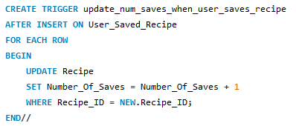
Trigger Implementation

Slide 19
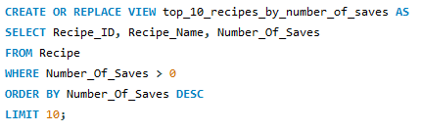
View Implementation

Slide 20
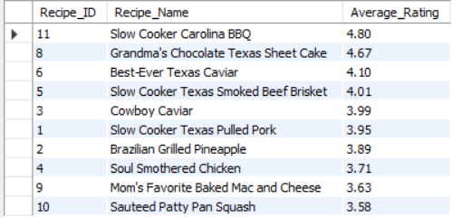
Testing Views
This view’s purpose is to get 10 highest average rating recipes. This also tested the trigger that calculates the new average rating when a review is created.

Slide 21
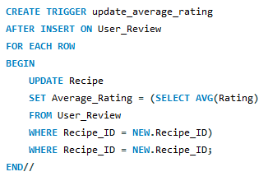
Trigger Implementation

Slide 22
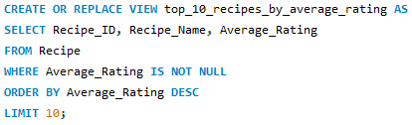
View Implementation

Slide 23
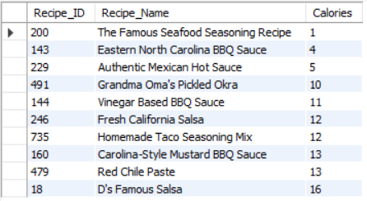
Testing Views
This view’s purpose is to get 10 lowest calorie recipes.

Slide 24
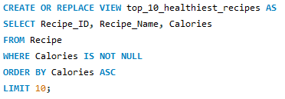
View Implementation

Slide 25
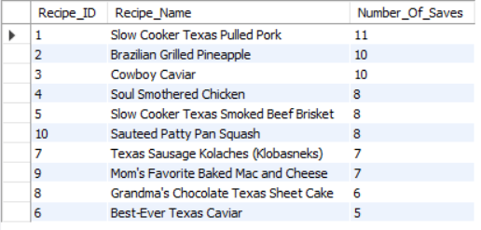
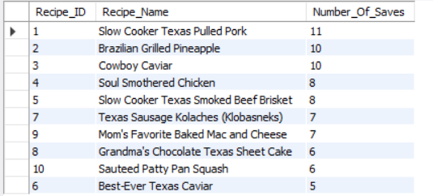
Testing Triggers
Trigger: Update the number of saves a recipe has when a user unsaves a recipe
In this example, we “unsave” recipe 10 twice, and the number of saves drops accordingly
Before
After

Slide 26
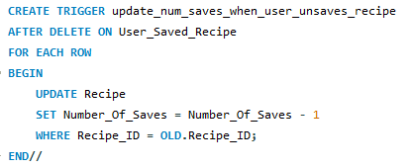
Trigger Implementation

Slide 27
Testing Triggers
Trigger: Don’t allow multiple recipes of the same name from the same user.
In this example, user “Example1@example.com” tried to create a recipe called “The Best Hamburger” for a second time, which causes the trigger to raise an error.

Slide 28
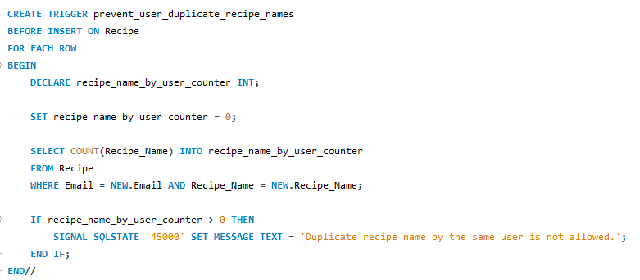
Trigger Implementation

Slide 29
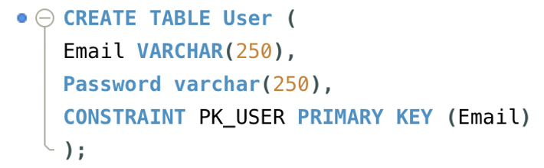
Normalization of Database Tables: User Table
Functional Dependency: Each unique email determines a password (Email → Password).
Normalization: Since all functional dependencies have a superkey on the left-hand side, the table satisfies BCNF.
Notes:
Axel

Slide 30
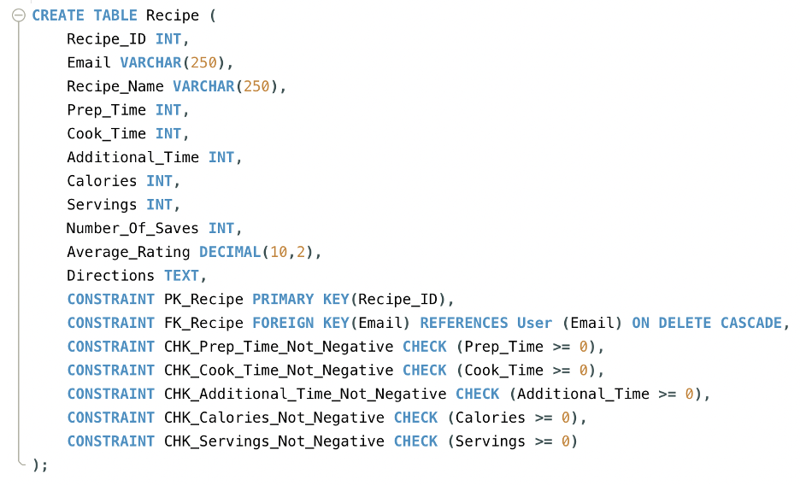
Normalization: Recipe Table
Functional Dependency: The primary key, Recipe_ID, uniquely determines all other attributes (Recipe_ID → any subset of the attributes Email, Recipe_Name, Prep_Time, Cook_Time, Additional_Time, Calories, Servings, Number_Of_Saves, Average_Rating, Directions).
Normalization: The table is in BCNF as all functional dependencies have a superkey on their left side.
Notes:
Axel

Slide 31
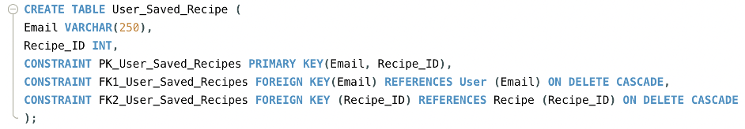
Normalization: User Saved Recipe Table
Modeling Approach: Each user can save multiple recipes, represented as a composite attribute in the ER diagram.
Primary Key: The composite primary key is the combination of Email and Recipe_ID.
Functional Dependencies: There are no functional dependencies as the full set of attributes forms the candidate key.
Normalization: The table is in BCNF
Notes:
Axel

Slide 32
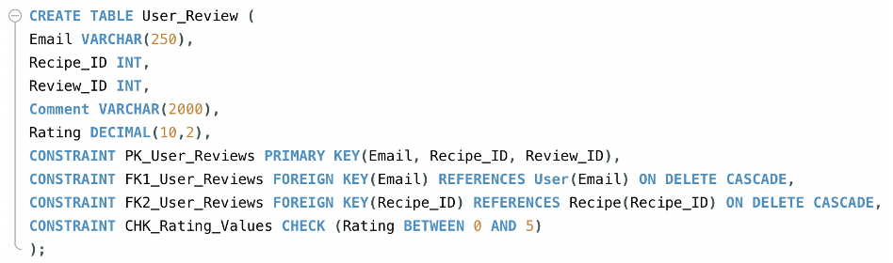
Normalization: User Review Table
Modeling Approach: Designed as a many-to-many relationship table linking User and Recipe tables, with Email and Recipe_ID initially as primary keys.
Primary Key Adjustment: Added Review_ID to the primary key to allow multiple reviews for the same recipe by a single user.
Functional Dependencies:
Composite dependency: (Email, Recipe_ID, Review_ID) → Comment, Rating.
Single attribute dependency: Review_ID → any subset of the attributes Email, Recipe_ID, Comment, Rating.
Candidate Key: Review_ID is the candidate key as it uniquely identifies each row.
Normalization: The table satisfies BCNF as all functional dependencies have a superkey on their left side.

Slide 33
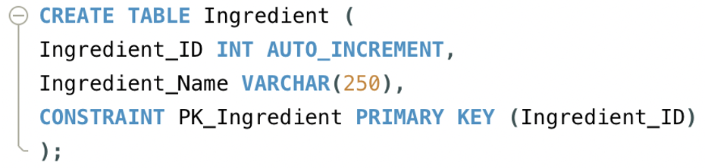
Normalization: Ingredient Table
Functional Dependency: The primary key, Ingredient_ID, uniquely determines Ingredient_Name (Ingredient_ID → Ingredient_Name).
Uniqueness: Ingredient_ID ensures each row is unique.
Normalization: The table is in BCNF as all functional dependencies have a superkey on their left side.

Slide 34
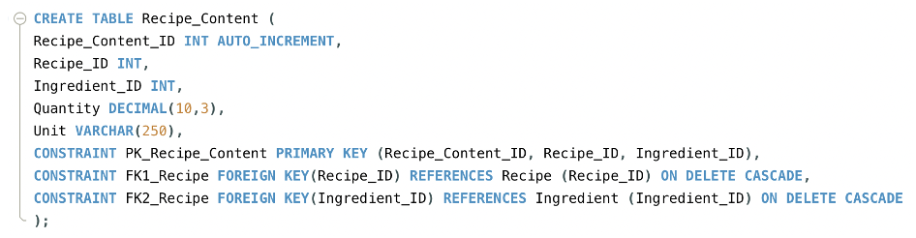
Normalization: Recipe Content Table
Modeling Approach: Designed as a many-to-many relationship table for recipes and ingredients with Recipe_ID and Ingredient_ID as initial keys.
Primary Key Adjustment: Added Recipe_Content_ID to the primary key to handle variations in ingredient quantity and units for recipes.
Functional Dependencies:
Composite dependency: (Recipe_Content_ID, Recipe_ID, Ingredient_ID) → Quantity, Unit.
Single attribute dependency: Recipe_Content_ID → any subset of the attributes Recipe_ID, Ingredient_ID, Quantity, Unit.
Candidate Key: Recipe_Content_ID uniquely identifies each row.
Normalization: The table satisfies BCNF as all functional dependencies have a superkey on their left side.

Slide 35
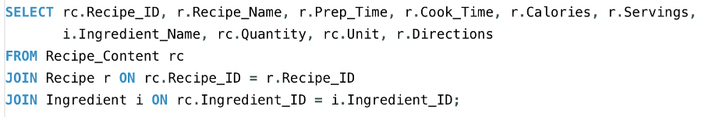
Query Optimization
Our database table with the most rows is Recipe_Content, with over 15000 rows and will continue to grow as more recipes are created.
The below query is commonly called to get information from recipes
This query causes a lot of I/Os in its current format
We added an index to alleviate this
Notes:
Alex

Slide 36
Query Optimization (Cont.)
We created a query using the following command
This would allow us to more efficiently compute this query, since both the Ingredient table and Recipe table are join by Recipe_Content, and we assumed a composite index would help
As shown in the next slide, adding the index does help the query run faster by performing less I/Os in both inner loops and the table scan
Notes:
Alex

Slide 37
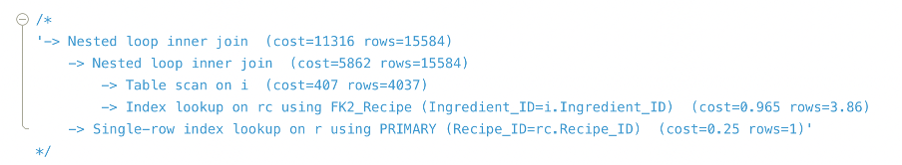
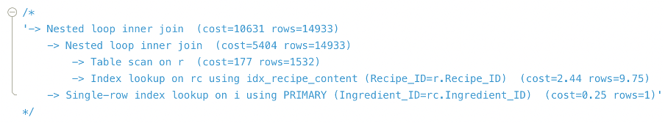
Query Optimization Results
Before:
After:
Notes:
Alex

Slide 38
The Website Layout

Slide 39
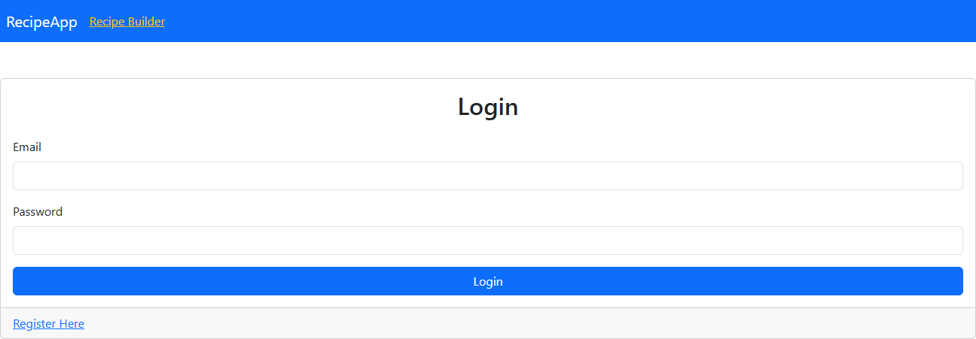
Webpages: Login Screen
Notes:
jaime/spencer

Slide 40
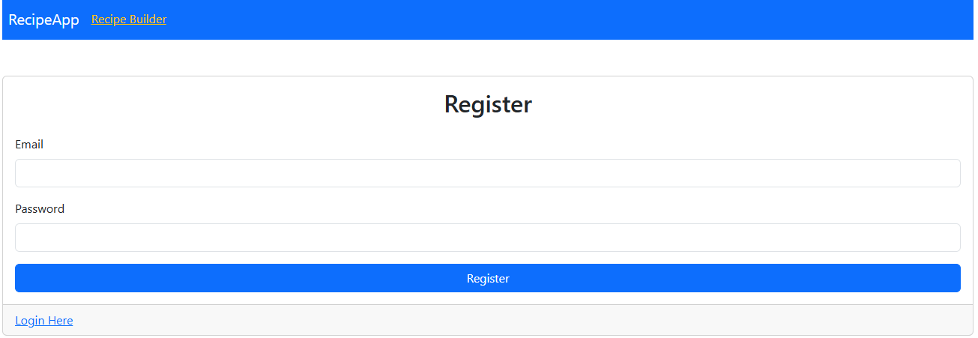
Webpages: Register User Page
Notes:
jaime/spencer

Slide 41
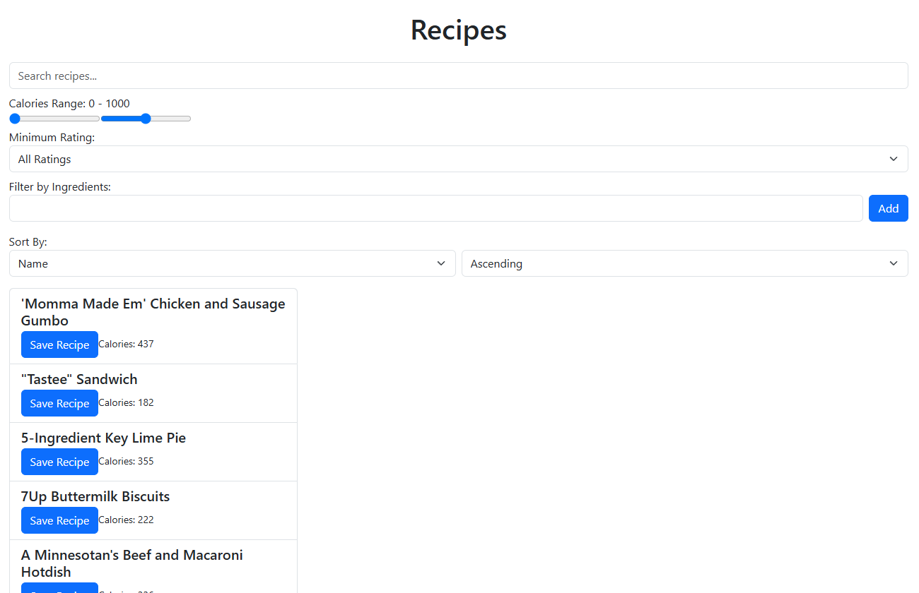
Webpages: Recipe Page
Notes:
jaime/spencer

Slide 42
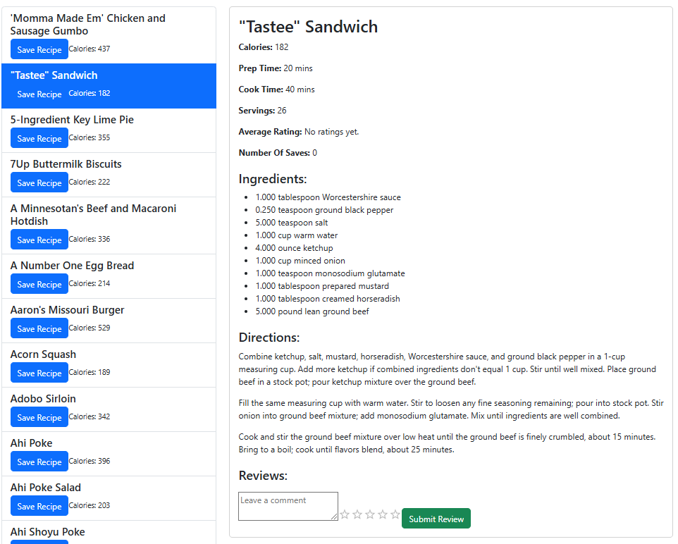
Webpages: Recipe Selected
Notes:
jaime/spencer

Slide 43
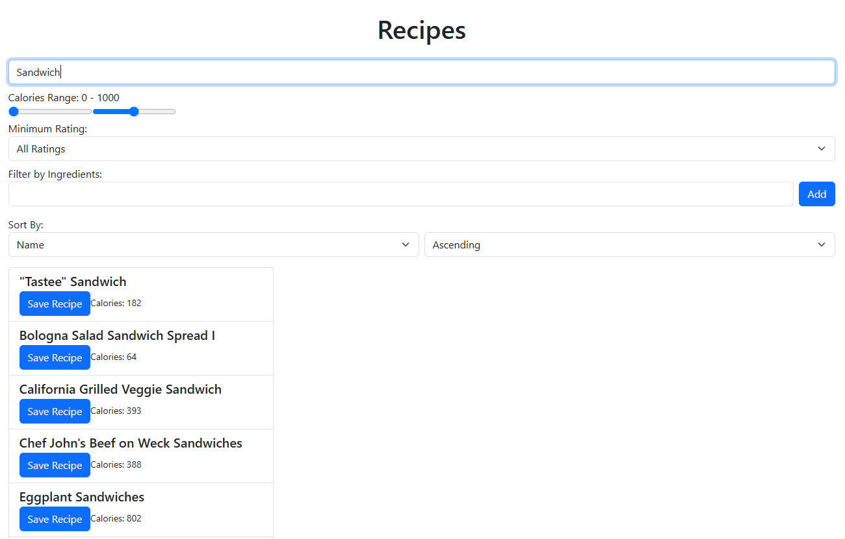
Webpages: Filtering by Recipe Name
Notes:
jaime/spencer

Slide 44
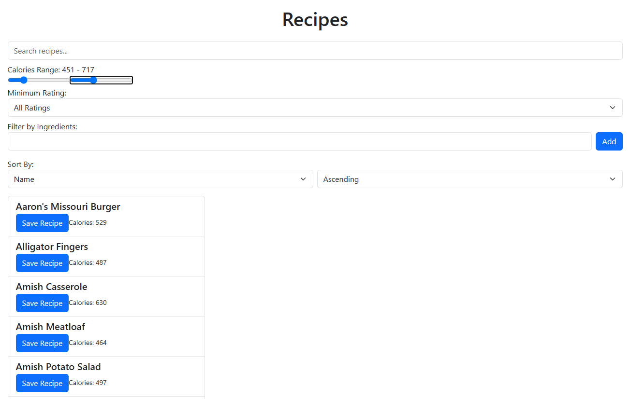
Webpages: Filtering by Calorie Count
Notes:
jaime/spencer

Slide 45
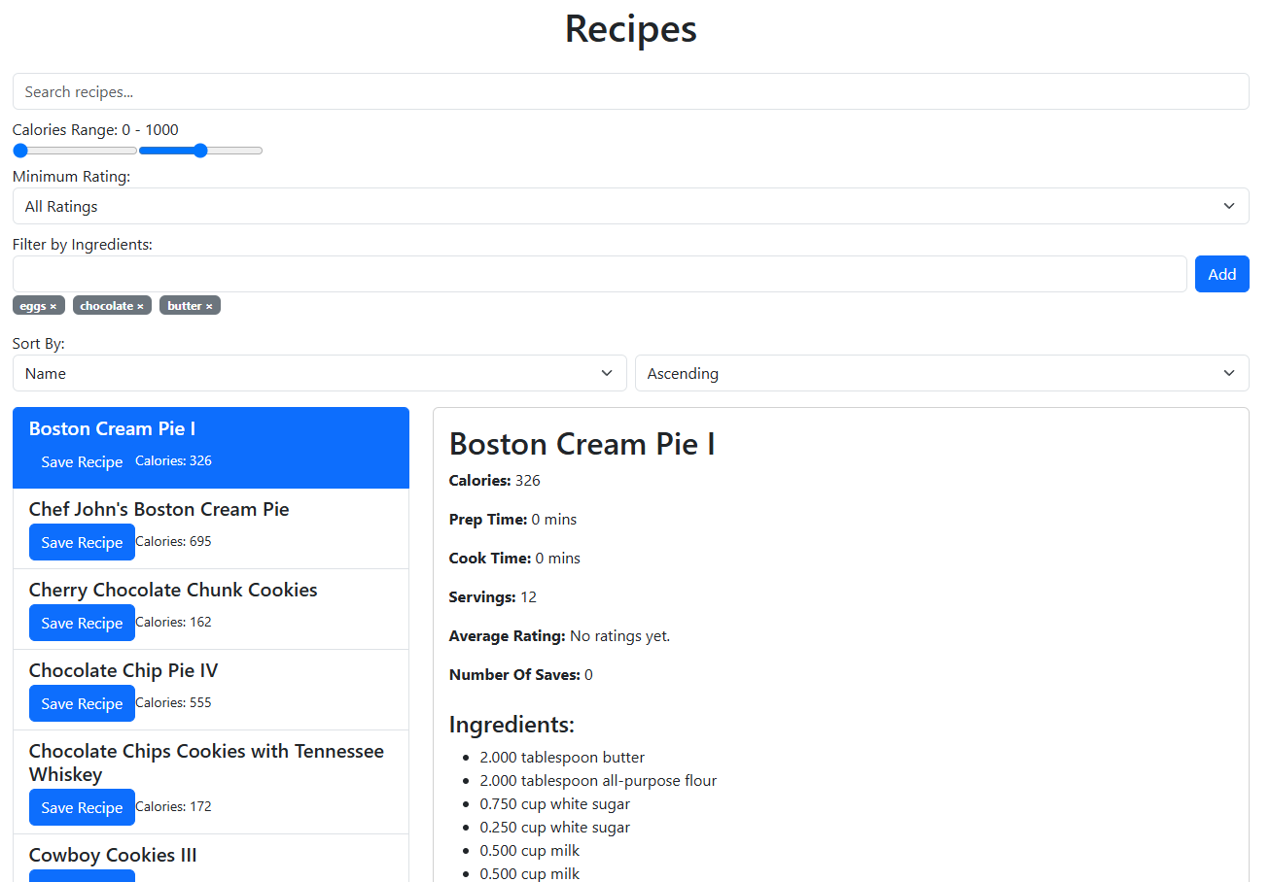
Webpages: Filtering by Ingredients
Notes:
jaime/spencer

Slide 46
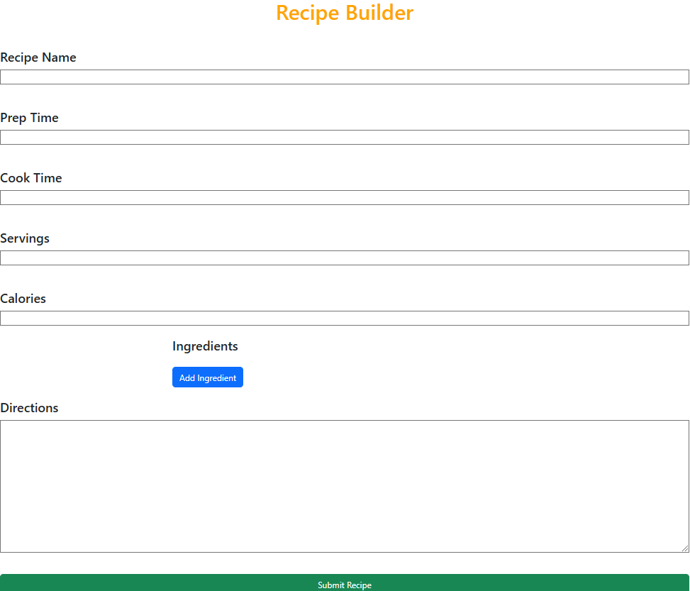
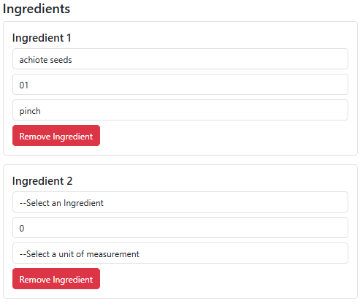
Webpage: Recipe Builder
Notes:
Alex/Axel

Slide 47
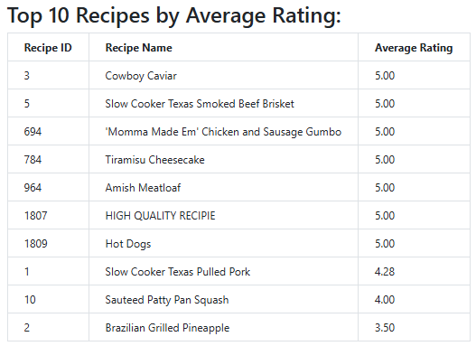
Webpages: Top 10 Views
Notes:
Axel

Slide 48
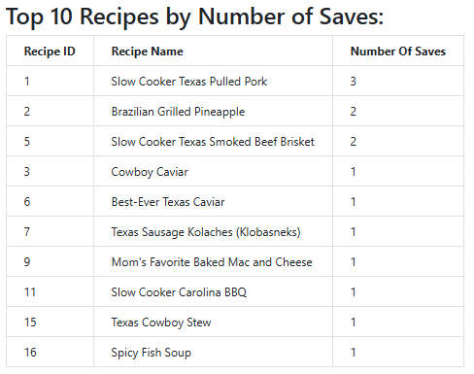
Webpages: Top 10 Views (Cont.)
Notes:
Axel

Slide 49
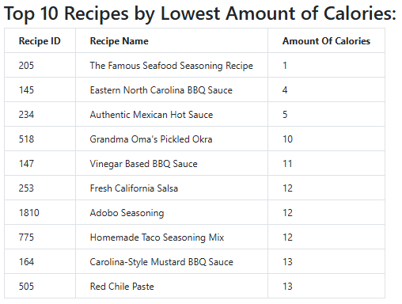
Webpages: Top 10 Views (Cont.)
Notes:
Axel

Slide 50
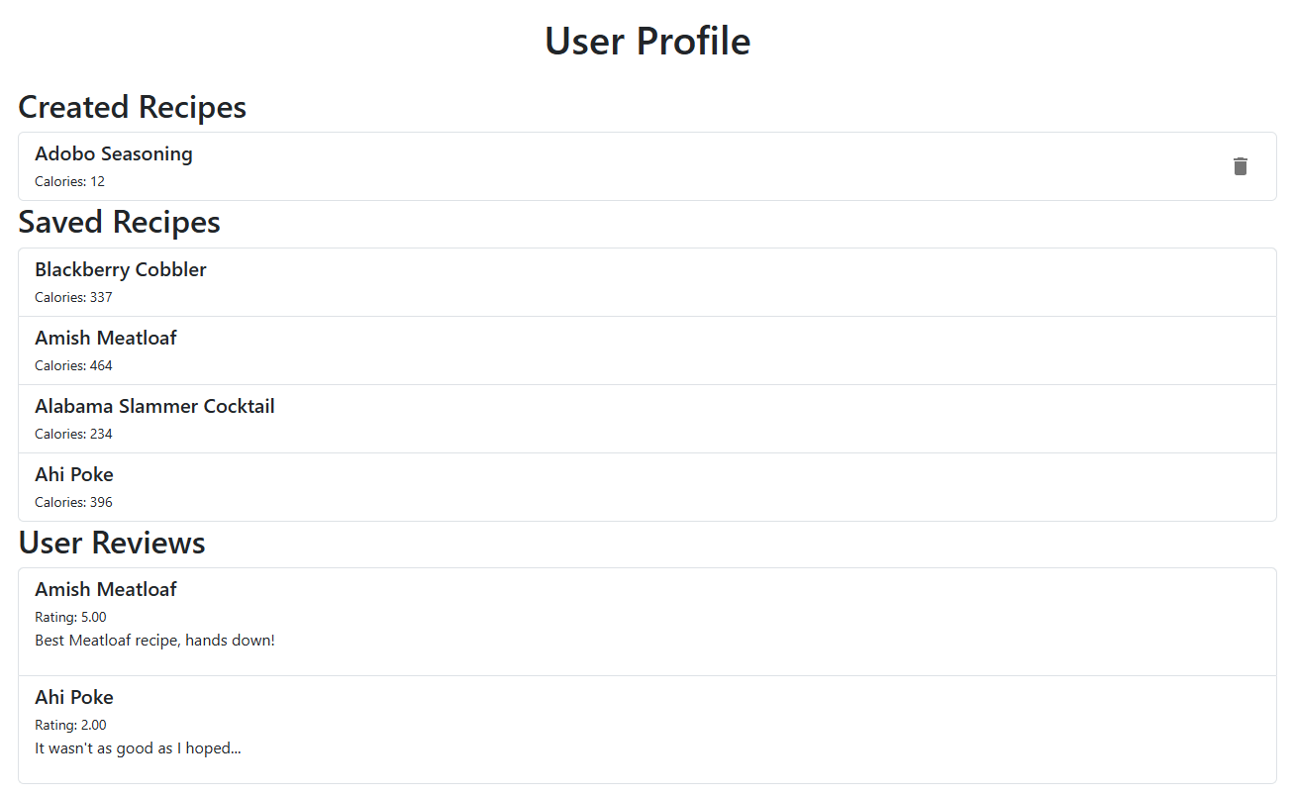
Webpage: Profile Page
Notes:
Sean

Slide 51
Future work:
Allow users to import their own ingredients, instead of being forced to choose from the existing list
Change the recipe webpage so that reviews are updated as soon as one is created by the user
Allow users to view other user’s profiles, which could allow for smaller communities to form within the platform
Adding a social media element to our website with people sharing tutorials or attempts of recipes they cooked
Prevent users from leaving multiple reviews on the same recipe
Instead it should update an existing review if one already exists, and if not create one
Notes:
Sean(?)

Slide 52
Access To Our Working Website
https://whats-cooking.fyi/

Slide 53
Video Demonstration Link
●https://wpi0-my.sharepoint.com/:v:/g/personal/jcordova_wpi_edu/EZeeI-oYLdxCpvUJPrXhsA4BwQa8_aSQ7iAFAZEUHWfOrg?nav=eyJyZWZlcnJhbEluZm8iOnsicmVmZXJyYWxBcHAiOiJTdHJlYW1XZWJBcHAiLCJyZWZlcnJhbFZpZXciOiJTaGFyZURpYWxvZy1MaW5rIiwicmVmZXJyYWxBcHBQbGF0Zm9ybSI6IldlYiIsInJlZmVycmFsTW9kZSI6InZpZXcifX0%3D&e=FZAUpg

Slide 54
References
Oracle. (2021). What is MySQL? Oracle. https://www.oracle.com/mysql/what-is-mysql/
Thomsen, C. (2002). Using Stored Procedures, Views, and Triggers: How to Use Stored Procedures, Views, and Triggers. In Database Programming with C# (pp. 367-412). Berkeley, CA: Apress.
Siahaan, V., & Sianipar, R. H. (2019). The Self-Taught Coder: The Definitive Guide to Database Programming with Python and MySQL (Vol. 1). SPARTA Publishing.
Stephens, J., & Russell, C. (2004). Optimizing Queries with Operators, Branching, and Functions. In Beginning MySQL Database Design and Optimization: From Novice to Professional (pp. 171-238). Berkeley, CA: Apress.
Komperla, Varun & Pratiba, Deenadhayalan & Ghuli, Poonam & Pattar, Ramakanthkumar. (2022). React: A detailed survey. Indonesian Journal of Electrical Engineering and Computer Science. 26. 1710. 10.11591/ijeecs.v26.i3.pp1710-1717.

